Slide 1
Straight Line
From a suggestion by Mark Richards (Lancaster Girls’ Grammar School) who got it from Bernard Murphy (MEI)

Slide 2
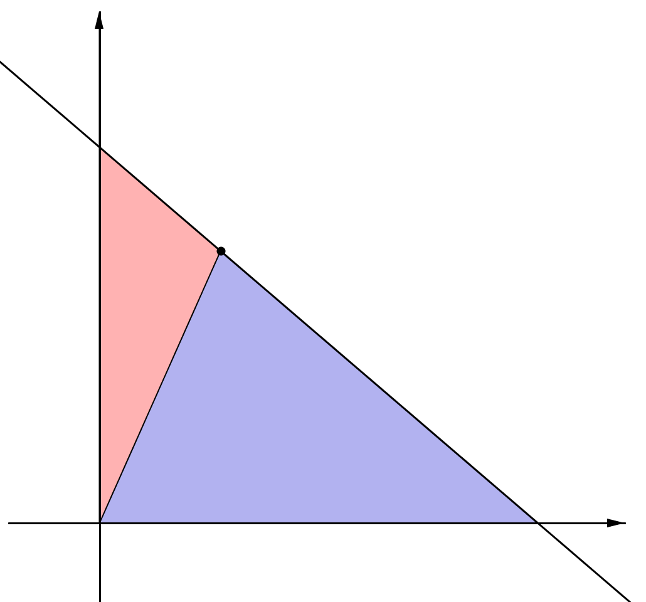






Straight Line
$$y$$
The point $P$ has coordinates $(x, y)$
Find, in terms of $x$, the area of the red triangle.
Find, in terms of $y$, the area of the blue triangle.
Find the numerical area of the triangle which is red and blue.
Hence find an equation linking $x$ and $y$.
What is the equation of the line?
$$7$$
$$P\left(x,y\right)$$
$$6$$
$$x$$
(not to scale)

Slide 3





Straight Line
$$y$$
area of the red triangle: $\frac{1}{2}ax$
area of the blue triangle: $\frac{1}{2}by$
area of the red and blue triangle: $\frac{1}{2}ab$
equating areas: $\frac{1}{2}ax+\frac{1}{2}by=\frac{1}{2}ab$
$ax+by=ab$
equation of the line: $y=−\frac{a}{b}x+a$
$by=−ax+ab$
$ax+by=ab$
$$a$$
$$P\left(x,y\right)$$
$$x$$
$$y$$
$$b$$
$$x$$
(not to scale)

Slide 5
RESOURCES

Slide 6
Straight Line
$$y$$
The point $P$ has coordinates $(x, y)$
Find, in terms of $x$, the area of the red triangle.
Find, in terms of $y$, the area of the blue triangle.
Find the numerical area of the triangle which is red and blue.
Hence find an equation linking $x$ and $y$.
What is the equation of the line?
$$7$$
$$P\left(x,y\right)$$
red
blue
$$6$$
$$x$$
(not to scale)
SIC_31

Slide 7

Straight Line
$$y$$
The point $P$ has coordinates $(x, y)$
Find, in terms of $x$, the area of the red triangle.
Find, in terms of $y$, the area of the blue triangle.
Find the numerical area of the triangle which is red and blue.
Hence find an equation linking $x$ and $y$.
What is the equation of the line?
$$7$$
$$P\left(x,y\right)$$
red
blue
$$5$$
$$x$$
(not to scale)
SIC_31

Slide 8

Straight Line
$$y$$
The point $P$ has coordinates $(x, y)$
Find, in terms of $x$, the area of the red triangle.
Find, in terms of $y$, the area of the blue triangle.
Find the numerical area of the triangle which is red and blue.
Hence find an equation linking $x$ and $y$.
What is the equation of the line?
$$8$$
$$P\left(x,y\right)$$
red
blue
$$6$$
$$x$$
(not to scale)
SIC_31

Slide 9


Straight Line
$$y$$
The point $P$ has coordinates $(x, y)$
Find, in terms of $x$, the area of the red triangle.
Find, in terms of $y$, the area of the blue triangle.
Find the numerical area of the triangle which is red and blue.
Hence find an equation linking $x$ and $y$.
What is the equation of the line?
$$6$$
$$P\left(x,y\right)$$
red
blue
$$8$$
$$x$$
(not to scale)
SIC_31

Slide 10

Straight Line
$$y$$
The point $P$ has coordinates $(x, y)$
Find, in terms of $x$, the area of the red triangle.
Find, in terms of $y$, the area of the blue triangle.
Find the numerical area of the triangle which is red and blue.
Hence find an equation linking $x$ and $y$.
What is the equation of the line?
$$3$$
$$P\left(x,y\right)$$
red
blue
$$5$$
$$x$$
(not to scale)
SIC_31

Slide 11

Straight Line
$$y$$
The point $P$ has coordinates $(x, y)$
Find, in terms of $x$, the area of the red triangle.
Find, in terms of $y$, the area of the blue triangle.
Find the numerical area of the triangle which is red and blue.
Hence find an equation linking $x$ and $y$.
What is the equation of the line?
$$5$$
$$P\left(x,y\right)$$
red
blue
$$8$$
$$x$$
(not to scale)
SIC_31

Slide 12

Straight Line
$$y$$
The point $P$ has coordinates $(x, y)$
Find, in terms of $x$, the area of the red triangle.
Find, in terms of $y$, the area of the blue triangle.
Find the numerical area of the triangle which is red and blue.
Hence find an equation linking $x$ and $y$.
What is the equation of the line?
$$2$$
$$P\left(x,y\right)$$
red
blue
$$5$$
$$x$$
(not to scale)
SIC_31

Slide 13

Straight Line
$$y$$
The point $P$ has coordinates $(x, y)$
Find, in terms of $x$, the area of the red triangle.
Find, in terms of $y$, the area of the blue triangle.
Find the numerical area of the triangle which is red and blue.
Hence find an equation linking $x$ and $y$.
What is the equation of the line?
$$11$$
$$P\left(x,y\right)$$
red
blue
$$8$$
$$x$$
(not to scale)
SIC_31

Slide 14
Straight Line
$$y$$
The point $P$ has coordinates $(x, y)$
Find, in terms of $x$, the area of the red triangle.
Find, in terms of $y$, the area of the blue triangle.
Find the numerical area of the triangle which is red and blue.
Hence find an equation linking $x$ and $y$.
What is the equation of the line?
6
$$P\left(x,y\right)$$
red
blue
$$5$$
$$x$$
(not to scale)
SIC_31

Slide 15

Straight Line
$$y$$
The point $P$ has coordinates $(x, y)$
Find, in terms of $x$, the area of the red triangle.
Find, in terms of $y$, the area of the blue triangle.
Find the numerical area of the triangle which is red and blue.
Hence find an equation linking $x$ and $y$.
What is the equation of the line?
$$7$$
$$P\left(x,y\right)$$
red
blue
$$10$$
$$x$$
(not to scale)
SIC_31

Slide 16

Straight Line
$$y$$
The point $P$ has coordinates $(x, y)$
Find, in terms of $x$, the area of the red triangle.
Find, in terms of $y$, the area of the blue triangle.
Find the numerical area of the triangle which is red and blue.
Hence find an equation linking $x$ and $y$.
What is the equation of the line?
$$12$$
$$P\left(x,y\right)$$
red
blue
$$5$$
$$x$$
(not to scale)
SIC_31

Slide 17

Straight Line
$$y$$
The point $P$ has coordinates $(x, y)$
Find, in terms of $x$, the area of the red triangle.
Find, in terms of $y$, the area of the blue triangle.
Find the numerical area of the triangle which is red and blue.
Hence find an equation linking $x$ and $y$.
What is the equation of the line?
$$12$$
$$P\left(x,y\right)$$
red
blue
$$6$$
$$x$$
(not to scale)
SIC_31

Slide 18

Straight Line
$$y$$
The point $P$ has coordinates $(x, y)$
Find, in terms of $x$, the area of the red triangle.
Find, in terms of $y$, the area of the blue triangle.
Find the numerical area of the triangle which is red and blue.
Hence find an equation linking $x$ and $y$.
What is the equation of the line?
$$12$$
$$P\left(x,y\right)$$
red
blue
$$11$$
$$x$$
(not to scale)
SIC_31

Slide 19

Straight Line
$$y$$
The point $P$ has coordinates $(x, y)$
Find, in terms of $x$, the area of the red triangle.
Find, in terms of $y$, the area of the blue triangle.
Find the numerical area of the triangle which is red and blue.
Hence find an equation linking $x$ and $y$.
What is the equation of the line?
$$12$$
$$P\left(x,y\right)$$
red
blue
$$13$$
$$x$$
(not to scale)
SIC_31

Slide 20


Straight Line
$$y$$
The point $P$ has coordinates $(x, y)$
Find, in terms of $x$, the area of the red triangle.
Find, in terms of $y$, the area of the blue triangle.
Find the numerical area of the triangle which is red and blue.
Hence find an equation linking $x$ and $y$.
What is the equation of the line?
$$13$$
$$P\left(x,y\right)$$
red
blue
$$4$$
$$x$$
(not to scale)
SIC_31

Slide 21


Straight Line
$$y$$
The point $P$ has coordinates $(x, y)$
Find, in terms of $x$, the area of the red triangle.
Find, in terms of $y$, the area of the blue triangle.
Find the numerical area of the triangle which is red and blue.
Hence find an equation linking $x$ and $y$.
What is the equation of the line?
$$17$$
$$P\left(x,y\right)$$
red
blue
$$4$$
$$x$$
(not to scale)
SIC_31

